Slide 1


Developing the functional R code for the bibliographic status of Antimicrobial-resistant research in Bangladesh from 2000 to 2023
Analysis Tutorial
BIO 5202 – Research Methods in Biology
Presented by
Md Mehadi Hasan Sohag
April 30, 2024

Slide 2


Antimicrobial resistance (AMR)
threatens the effective prevention and treatment of an ever-increasing range of infections caused by micro-organisms.
AMR occurs
when bacteria, viruses, fungi, and parasites change over time and no longer respond to medicines making infections harder to treat and increasing the risk severe illness, and death.
As a result,
the medicines become ineffective and infections persist in the body, increasing the risk of spread to others.
Improper antimicrobial dosage and use
Lack of proper national guidelines
doctors prescribe antibiotics sub-optimally up to half the time, either when not needed or with incorrect dosing or duration.
Social Awareness
Superbugs

Slide 3
Antimicrobial resistance (AMR) Fact Sheet
It is estimated that bacterial AMR was directly responsible for 1.27 million global deaths in 2019 and contributed to 4.95 million deaths
In 2013, CDC has estimated 20,49,442 illness and 23,000 deaths
But in 2019, the CDC has recalculated the estimation 28,68,700 with more than 35,000 deaths.
The scenario of AMR is nothing but global and the global scenario is anyway alarming .
The scenario is most vulnerable in Africa and Asia, mostly in South Asia.

Slide 4
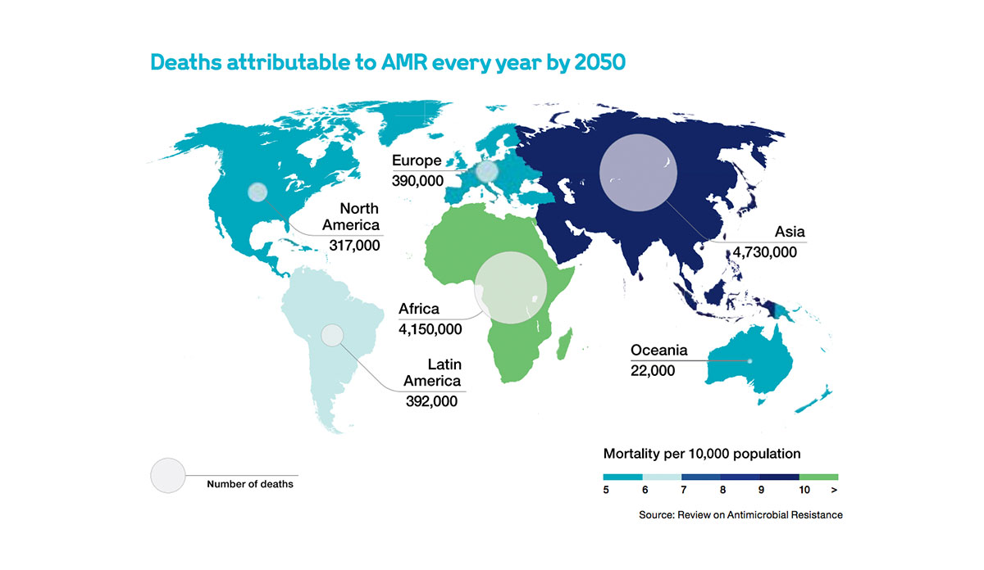

Slide 5
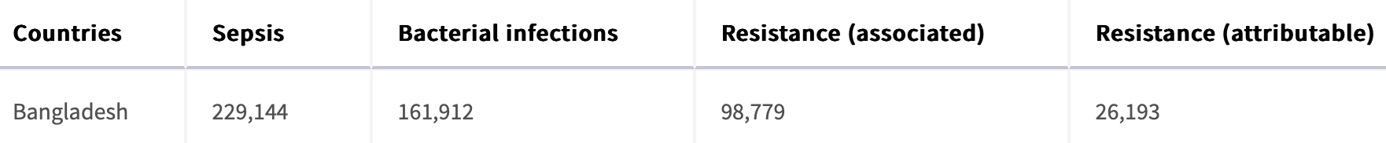
Why is bibliographic study important?
Give the insight of the research trends
Wholesome summary of the problems and consequences
Draw the attention of the policy makers (third world​) through the recommendations
Bangladesh?
We are the neighbouring country of the AMR capital of the World "India"
So, I would like to make my tutorial analysis by using some functions of R programming to prepare the bibliographic status of antimicrobial resistance research in Bangladesh from 2000 to 2023.

Slide 6


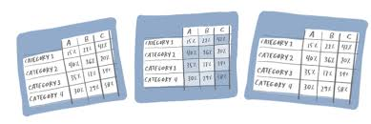



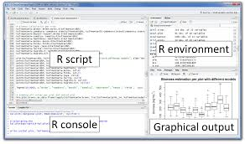
Collecting literature
Make the data table
Analysis Tutorial Workflow
Data import into R
Create a GitHub repository and upload .R file of this tutorial
Visualization
Coding for the bibliographic status

Slide 7
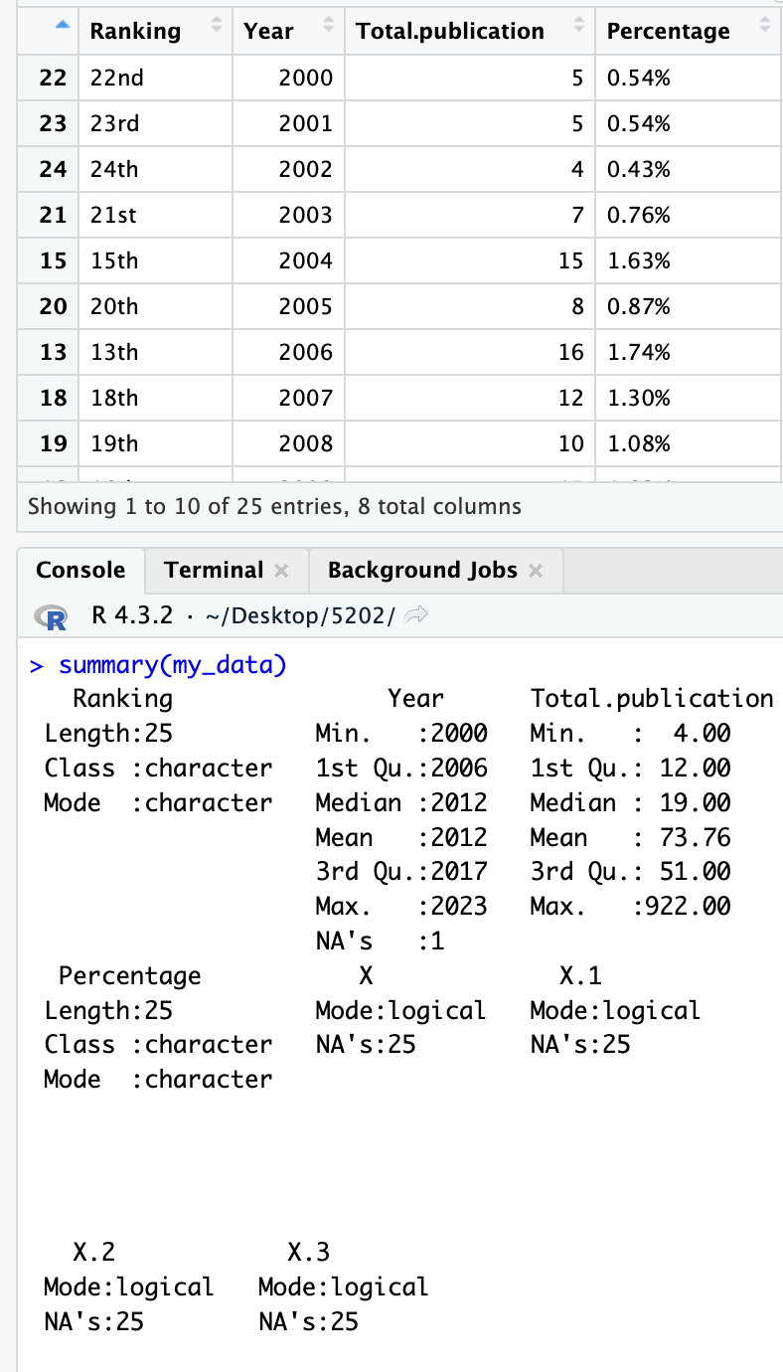
Summary of the Bibliographic Status

Slide 8
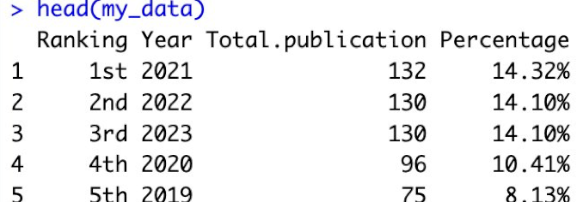
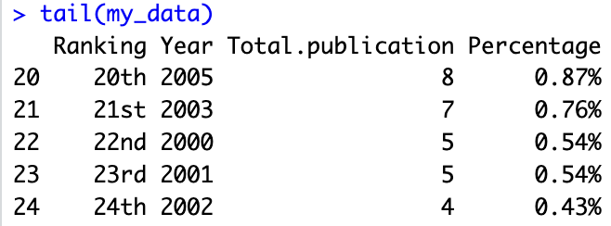
Top 5 years in publishing more articles
Top 5 years in publishing less articles
Total Publications in 23 years

Slide 9
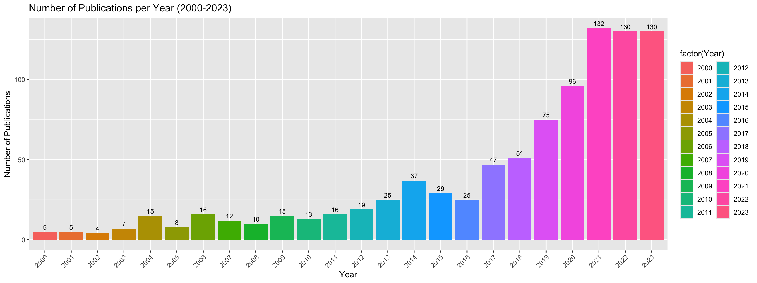
Visualizing the Histogram of the AMR publications Per Year (over the years)

Slide 10
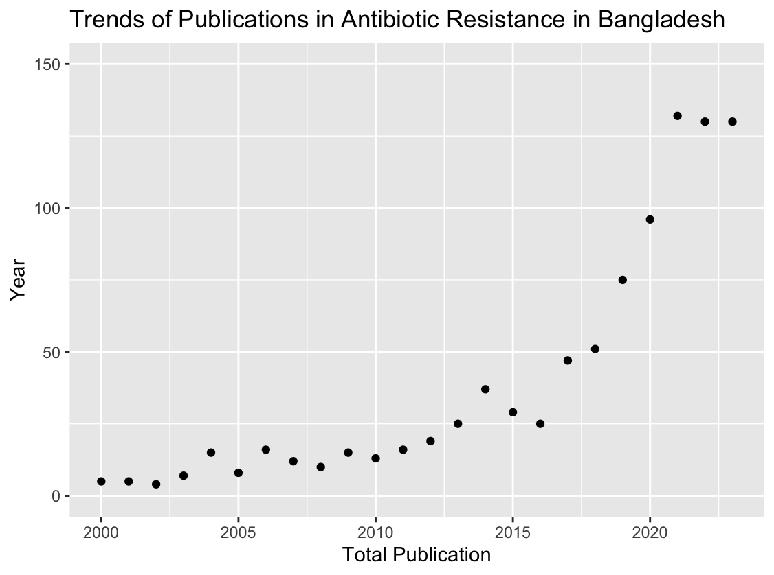

Slide 11
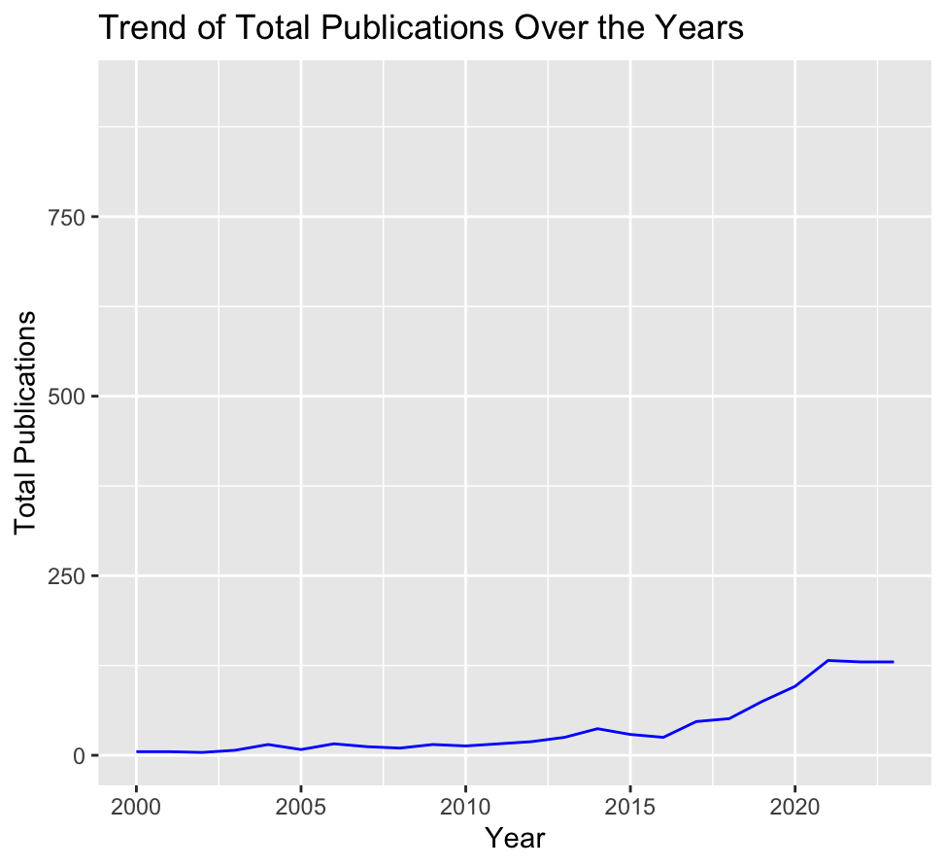
Publication Trends over the years

Slide 12
Annual Growth Rate (AGR )
Quantitative data about the growth of science
Positive shift of the research in the concern issue/problems
Indicates the intensity of the problems
Doubling Time (Dt)
The amount of time it takes for a value to double itself at a consistent rate of growth
Another supplementary indicator of the intensity of the research problem during the years

Slide 13
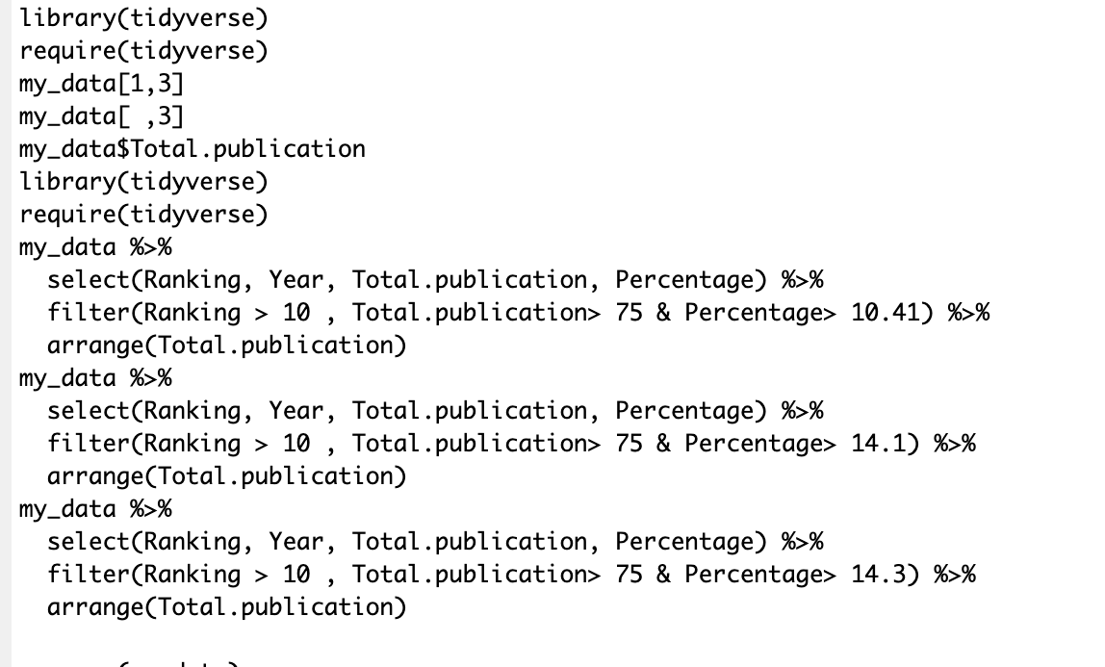
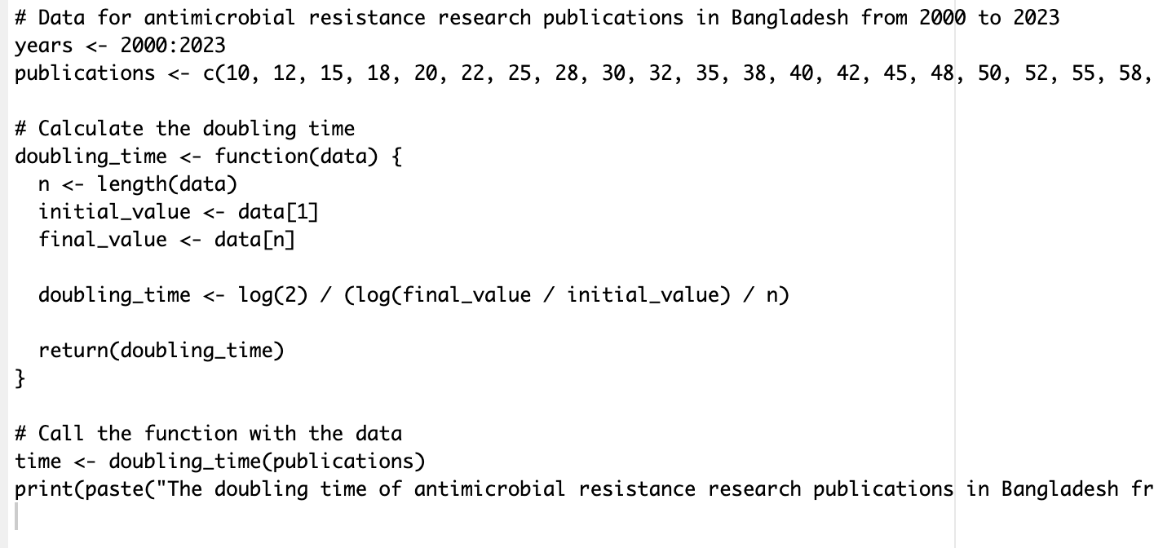
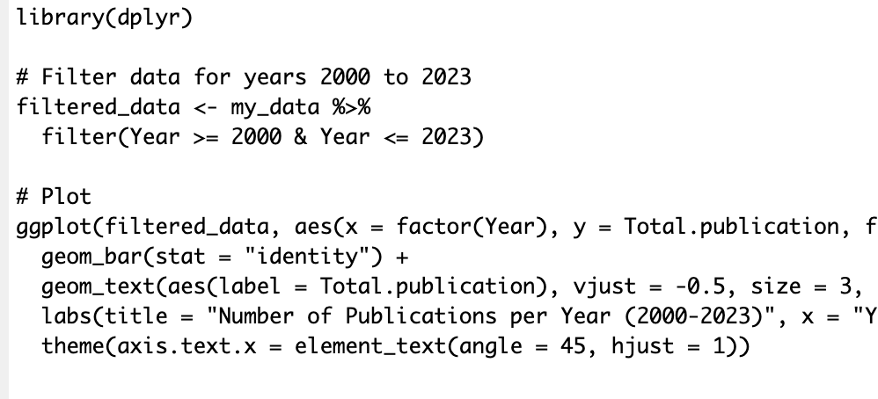
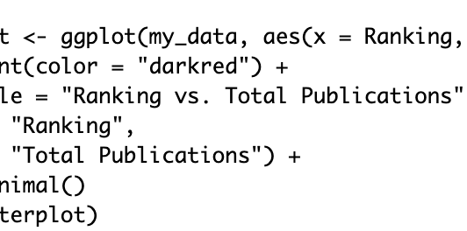
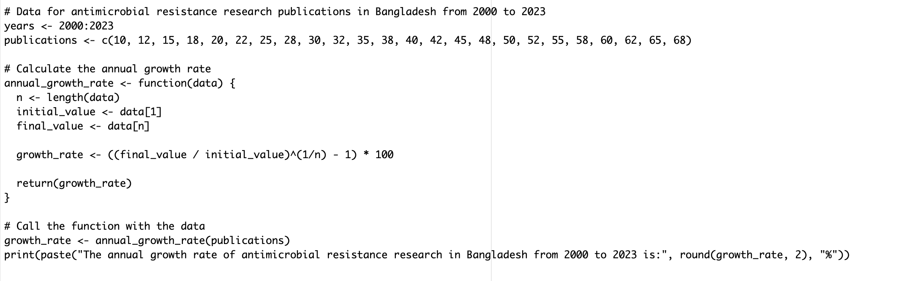

Slide 14
References
Faiz, M. A., & Basher, A. (2011, September). Antimicrobial resistance: Bangladesh experience. In Regional Health Forum (Vol. 15, No. 1, pp. 1-8).
2. Sweileh, W. M. (2021). Global research publications on irrational use of antimicrobials: call for more research to contain antimicrobial resistance. Globalization and Health, 17(1), 94.
3. Monjur, F., Rizwan, F., Asaduzzaman, M., Nasrin, N., Ghosh, N. K., Apu, A. S., & Haque, F. (2010). Antibiotic sensitivity pattern of causative organisms of neonatal septicemia in an urban hospital of Bangladesh. Indian J Med Sci, 64(6), 265-271.
4. R Core Team. 2024. R: A Language and Environment for Statistical Computing. From https://www.r-project.org/
5. AMR. IHME. 2019. https://www.healthdata.org/antimicrobial-resistance
6. Hoque R, Ahmed SM, Naher N, Islam MA, Rousham EK, Islam BZ, et al. (2020) Tackling antimicrobial resistance in Bangladesh: A scoping review of policy and practice in human, animal and environment sectors. PLoS ONE 15(1): e0227947.
7. Antimicrobial Resistance Collaborators. (2022). Global burden of bacterial antimicrobial resistance in 2019: a systematic analysis. The Lancet; 399(10325): P629-655.
8. Murray, C. J., Ikuta, K. S., Sharara, F., Swetschinski, L., Aguilar, G. R., Gray, A., ... & Tasak, N. (2022). Global burden of bacterial antimicrobial resistance in 2019: a systematic analysis. The lancet, 399(10325), 629-655

Slide 15


